Slide 1

Machine Learning Methods to Screen Compounds Targeting COVID-19
August 9, 2022
Team 4: Marina Dunn, Lance Fletcher,
Moises Santiago Cardenas, Robert Stephany
DSSI Challenge Problem

Slide 2
Approach
Classifers
Ensemble
Task 2
3D CNN
GNN
Task 1
Exploratory Data Analysis

Slide 3
Task 1
Molecular Descriptors

Slide 4
Exploratory Data Analysis
Data Cleaning:
Numerical & Non-numerical statistics
Drop columns & rows
Sorting, Indexing, Grouping, etc.
Duplicates, Missing data, Outliers
Fill missing features with mean
Scale data

Slide 5
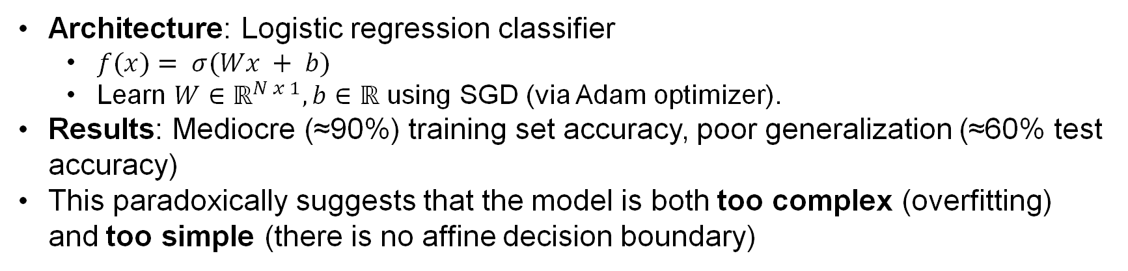
First Attempt: Logistic Regression Classifier
Architecture: Logistic regression classifier
$f(x)= σ(Wx + b)$
Learn $W∈ℝ^{N x 1}, b∈ℝ$ using SGD (via Adam optimizer).
Results: Mediocre (≈90%) training set accuracy, poor generalization (≈60% test accuracy)
This paradoxically suggests that the model is both too complex (overfitting) and too simple (there is no affine decision boundary)
x₂
x₁
x₃
x_{N}
b
…
σ

Slide 6
Second Attempt: Feature Subset
Architecture: MLP that accepts a subset of the input features
Uses ≈ 100 of 208 features
3 hidden layers (40-20-10 units)
Can learn a complex decision boundary
Results: Some models generalize well (> 75%), others do not (< 60%)
This suggest that some combinations features are more useful than others
x₂
Sample
x₁
x₃
x_{N}
b
b
…
b
σ

Slide 7
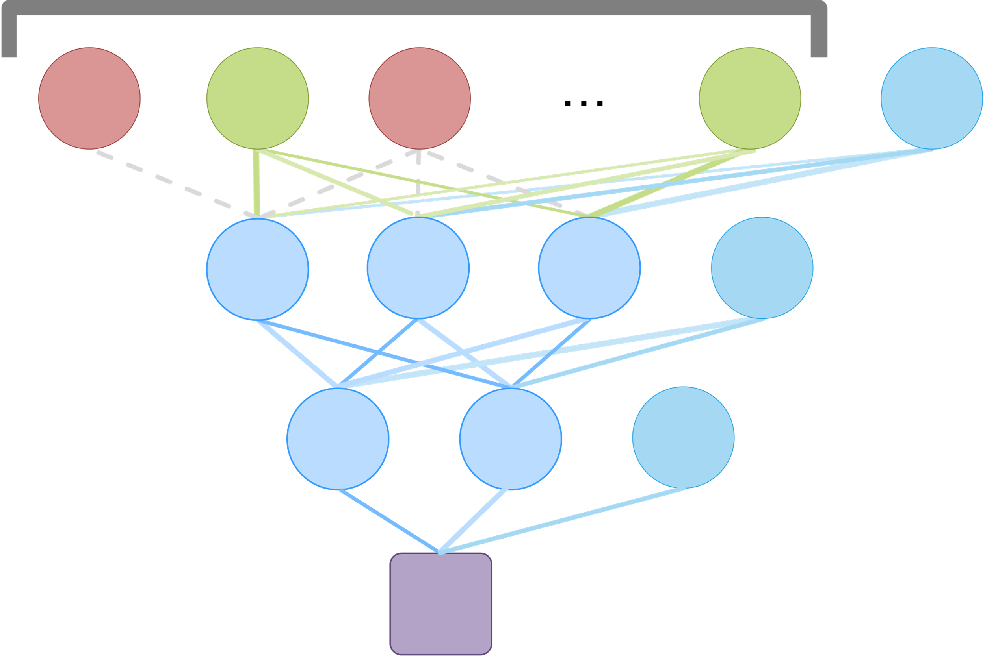
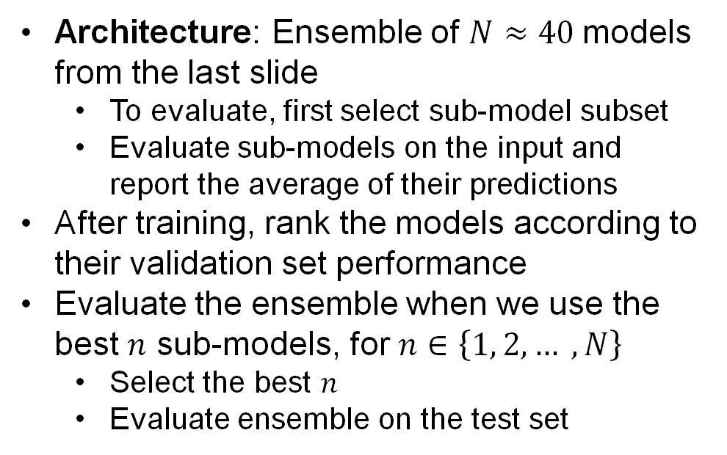
Third Attempt: Ensemble Approach
Architecture: Ensemble of $N≈40$models from the last slide
To evaluate, first select sub-model subset
Evaluate sub-models on the input and report the average of their predictions
After training, rank the models according to their validation set performance
Evaluate the ensemble when we use the best $n$ sub-models, for $n∈\left\{1, 2, … , N\right\}$
Select the best $n$
Evaluate ensemble on the test set
40
X
…
Set | Accuracy | Precision | Recall | F1
Train | 99.1% | .988 | .992 | .990
Validation | 88.4% | .836 | .836 | .876
Test | 80.5% | .740 | .740 | .812

Slide 8
First Attempt Models
Changed train-test ratio, used class weights, tried for both cleaned full & smaller datasets
Used scikit-learn grid search for 11 initial models:
Linear & Non-linear Support Vector Classifiers
K-Nearest Neighbors Classifier
Gaussian Process Classifier
Decision Tree & Random Forest Classifiers
Ada Boost Classifier
Bagging Classifier
Gaussian Naïve-Bayes
Quadratic Discriminant Analysis
Neural Network

Slide 9
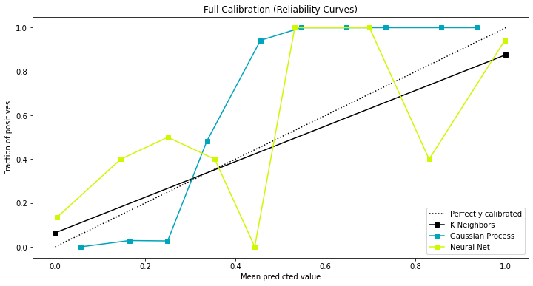
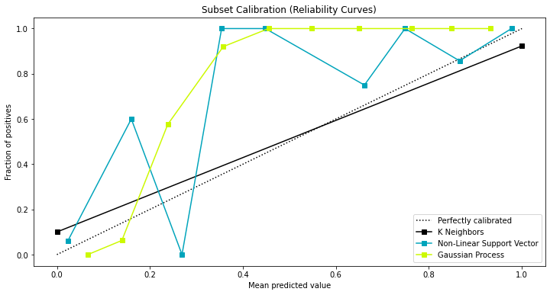
Classifier Results
Model | Accuracy | Precision (weighted) | Recall (weighted) | F1 (weighted)
K-Nearest Neighbors | 89% (full) 94% (small**) | 90% (full) 94% (small**) | 89% (full) 94% (small**) | 89% (full) 94% (small**)
Gaussian Process | 88% (full) 90% (small**) | 89% (full) 90% (small**) | 88% (full) 90% (small**) | 88% (full) 90% (small**)
Neural Network | 89% (full) | 89% (full) | 89% (full) | 89% (full)
** Refers to smaller data subset with rows 4+ standard deviations away from mean removed; scores less meaningful for this data.

Slide 10
Task 1 Challenges
Data Cleaning: fewer samples, data imbalance
Dataset nuances
Scientific background
Time Constraints
Look at additional metrics (ROC AUC, etc.)
Try fusion of models (i.e. average final layer activations)
Additional feature analysis
If We Had More Time….

Slide 11
Task 2
3D Ligand Structures

Slide 12
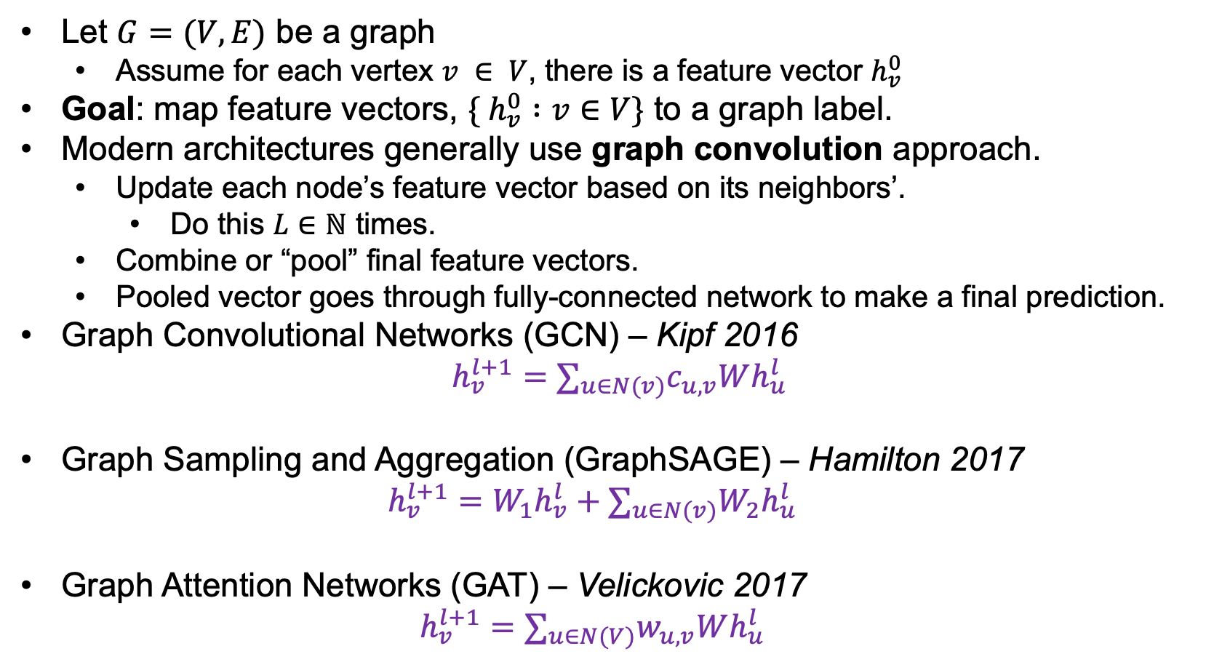
Graph Neural Network Convolutions
Let $G=(V, E)$ be a graph
Assume for each vertex $v ∈ V$, there is a feature vector $h_{v}^{0}$
Goal: map feature vectors, $\{ h_{v}^{0} :v∈V\}$ to a graph label.
Modern architectures generally use graph convolution approach.
Update each node’s feature vector based on its neighbors’.
Do this $L∈ℕ$ times.
Combine or “pool” final feature vectors.
Pooled vector goes through fully-connected network to make a final prediction.
Graph Convolutional Networks (GCN) – Kipf 2016
$$h_{v}^{l+1}=∑_{u∈N(v)}c_{u,v}Wh_{u}^{l}$$
Graph Sampling and Aggregation (GraphSAGE) – Hamilton 2017
$$h_{v}^{l+1}=W_{1}h_{v}^{l}+∑_{u∈N(v)}W_{2}h_{u}^{l}$$
Graph Attention Networks (GAT) – Velickovic 2017
$$h_{v}^{l+1}=∑_{u∈N(V)}w_{u, v}Wh_{u}^{l}$$
Notes:
Kipf - https://arxiv.org/abs/1609.02907
Hamilton - https://proceedings.neurips.cc/paper/2017/hash/5dd9db5e033da9c6fb5ba83c7a7ebea9-Abstract.html
Velickovic - https://arxiv.org/abs/1710.10903

Slide 13
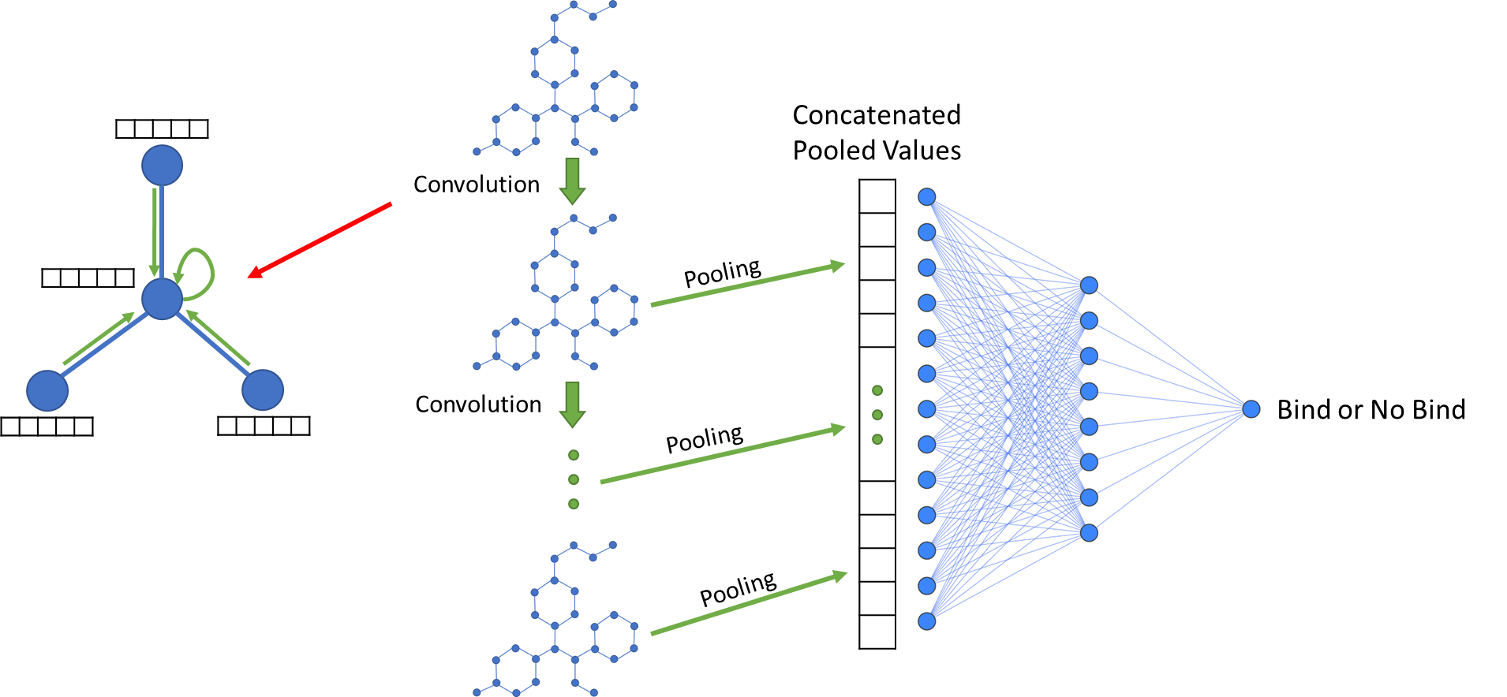
Graph Neural Network Architecture
GCN, GraphSAGE, GAT

Slide 14
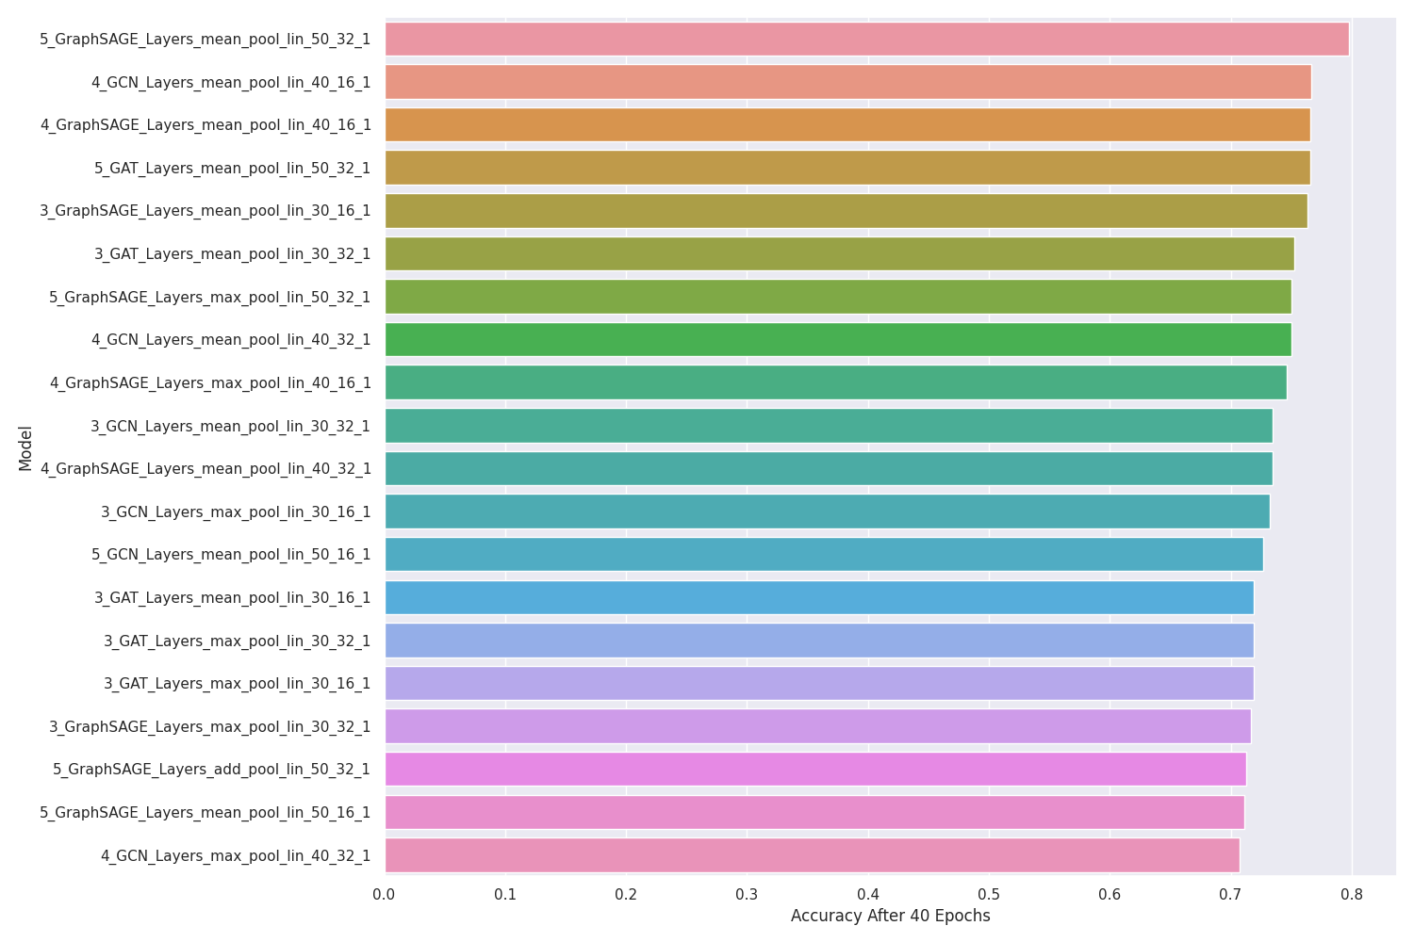
GNN – Hyperparameter Search

Slide 15
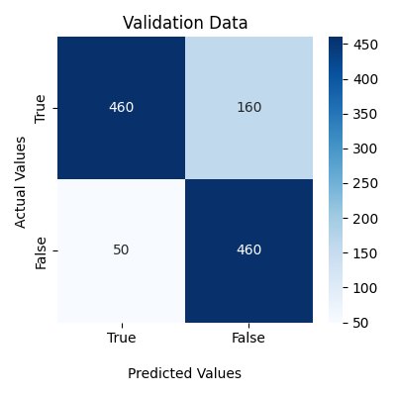
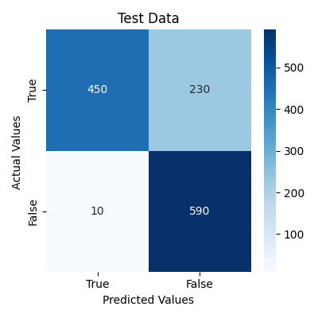
Ensemble GNN Results
5 Layer GraphSAGE Mean Pool
Accuracy: 81.42%
5 Layer GCN Max Pool
4 Layer GraphSAGE Mean Pool
Average Prediction
Bind, No Bind
Round()
4 Layer GCN Mean Pool
Accuracy: 81.25%
5 Layer GAT Mean Pool

Slide 16
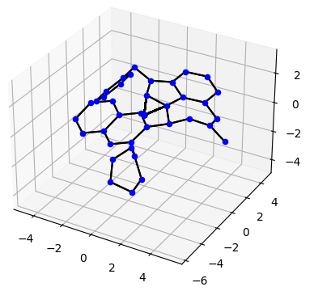
If We Had More Time….
Explore & test with other kinds of pooling
Our hyperparameter search suggests that pooling type is the most important variable
Weight “binding” examples more than “non-binding”
Try other ensemble methods (Bagging, Stacking, Boosting)
Investigate mixing different convolution layers in a single architecture
Explore different methods of translating ligand data to a graph

Slide 17
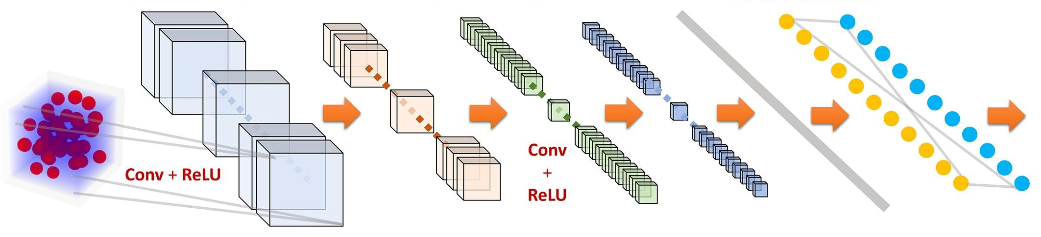
3D Convolutional Neural Networks
Used TensorFlow to build models similar to Stevenson et al. (2021):
Adam Optimizer
Binary Cross-entropy Loss Function
Use Early-Stopping
Measure Accuracy, Precision, Recall, F1
Use class weights
32@5x5x5
Pooling 2x2x2
64@3x3x3
Pooling 2x2x2
Flattening
Fully Connected Layers: 128 nodes
19550@48x48x48x19

Slide 18
3D CNN Challenges
Data Extraction & Restructuring
SLURM Allocation & LC System Issues
Time Constraints
If We Had More Time….
Test more architectures and implement fusion model
Try Binary Focal Cross-entropy Loss
Explore using uncertainty quantification
Do comprehensive performance and behavior analysis

Slide 19

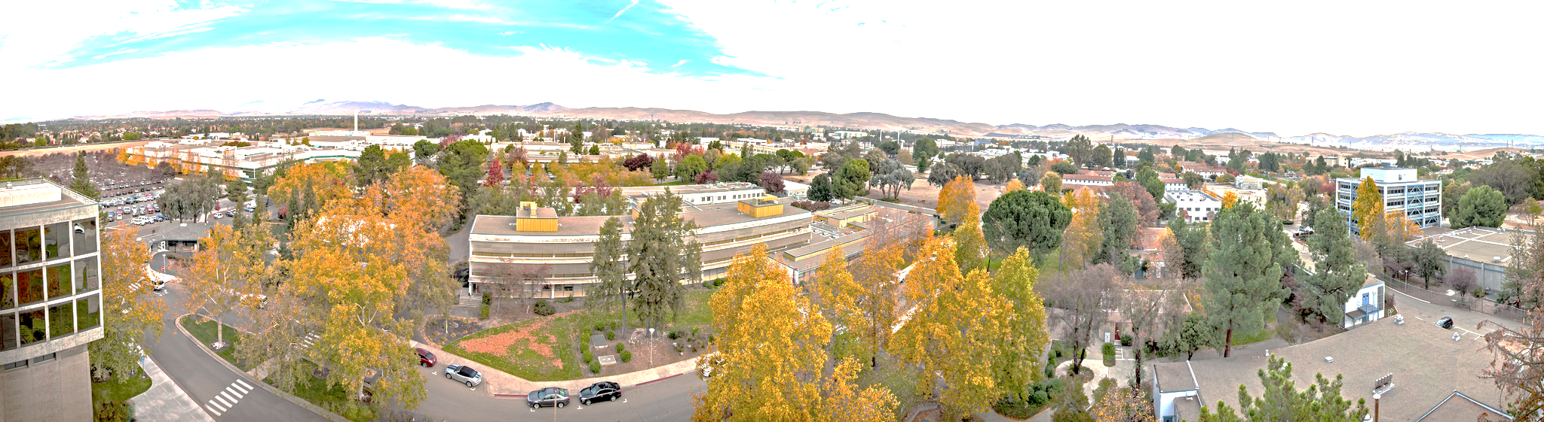

Thank You!
Jen Bellig
Nisha Mulakken
Goran Konjevod
Hyojin Kim
Garret Stevenson
Derek Jones
DSSI Course Lecturers
Public Github repo:

Slide 20
Disclaimer
This document was prepared as an account of work sponsored by an agency of the United States government. Neither the United States government nor Lawrence Livermore National Security, LLC, nor any of their employees makes any warranty, expressed or implied, or assumes any legal liability or responsibility for the accuracy, completeness, or usefulness of any information, apparatus, product, or process disclosed, or represents that its use would not infringe privately owned rights. Reference herein to any specific commercial product, process, or service by trade name, trademark, manufacturer, or otherwise does not necessarily constitute or imply its endorsement, recommendation, or favoring by the United States government or Lawrence Livermore National Security, LLC. The views and opinions of authors expressed herein do not necessarily state or reflect those of the United States government or Lawrence Livermore National Security, LLC, and shall not be used for advertising or product endorsement purposes.

